Slide 1
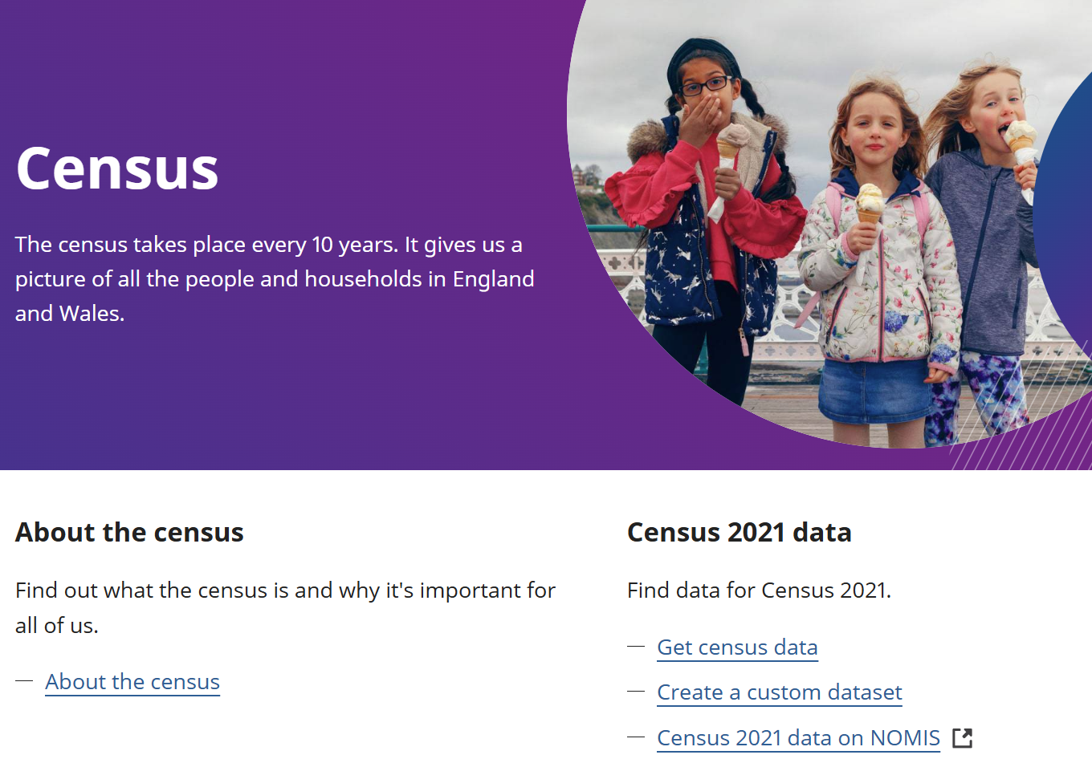
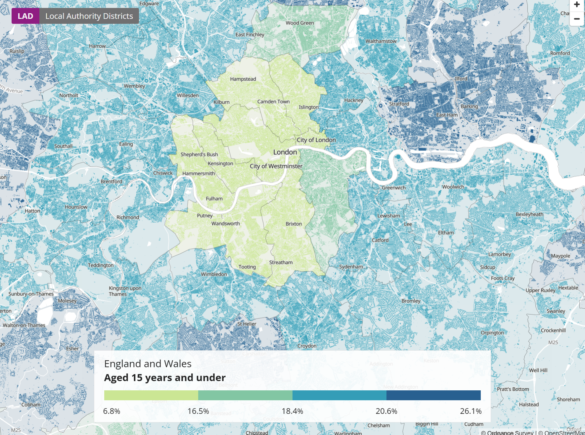
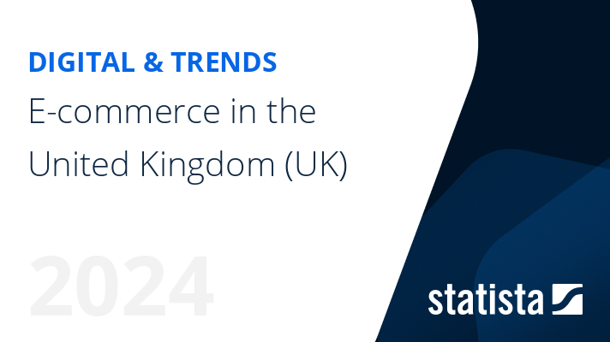
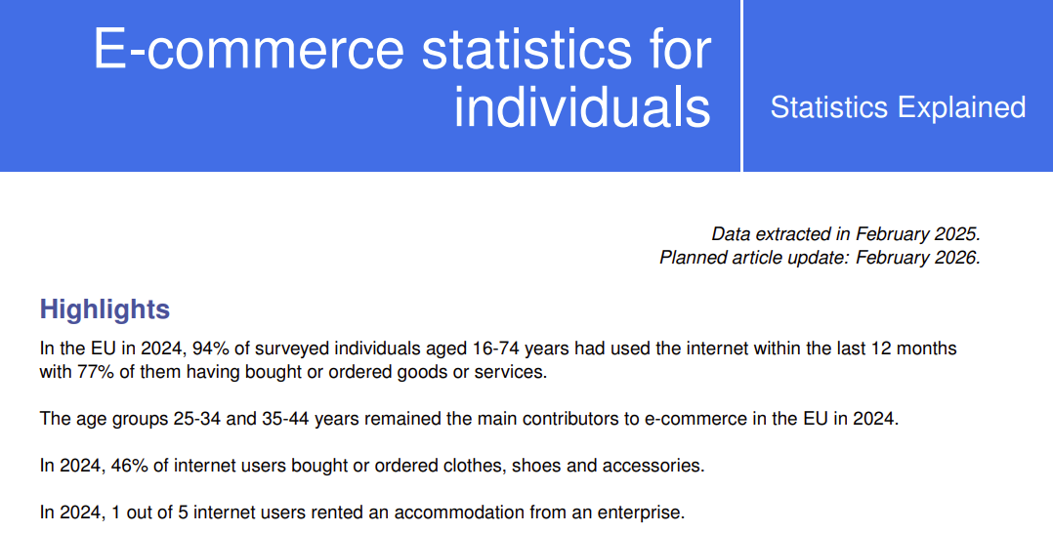
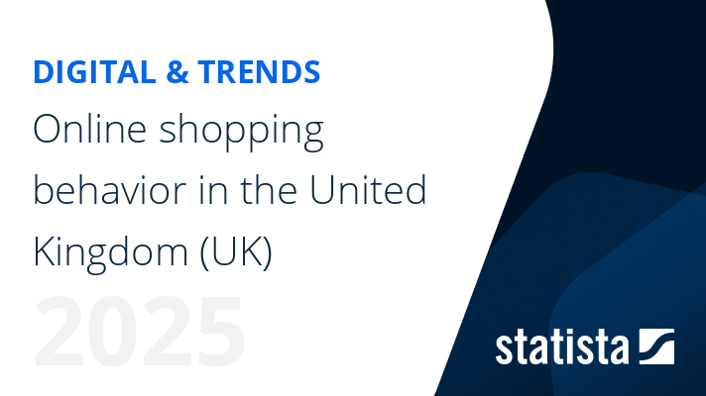



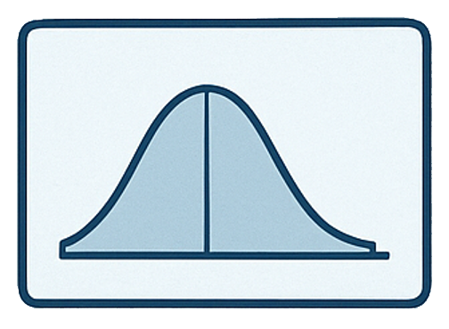

Micro Sample Data
Census Statistics
Muti-source
E-commerce Reports
Synthetic Poputation Generation
E-commerce Behaviour Modelling
Synthetic Population
Fuzzy Inference
Rule Bases
Attributes:
Age
Sex
Location
Economic activity
....
Modules:
Availability
Frequency
Order Category
SYNTHETIC POPULATIUON
E-COMMERCE
BEHAVIOUR
Synthetic Order Generation: Monte Carlo Sampling
Components
Input: Open-source Data
MONTE CARLO SAMPLING
Framework Module
Synthetic Order
Module Output
Attributes:
Customer features
Order Category
Value
Weight
Destination
Components
Process Output
Census Statistics
Input Data
Functional Process
Micro Sample Data
Initialize Weights based on Microdata
Adjust Weights for Each Feature
Check Convergence, Marginals with Constraints
If meet Threshold?
Yes
Data Output:
Synthetic Population
No

Slide 2
Behaviour Modelling: Fuzzy Inference System
Demand Generation: Monte Carlo (MC) Sampling
Multi-Source E-commerce Reports
Synthetic Population Instance
Demographic Features
Age
Sex
Marital Status
...
Non-online Customer
No
Available?
Bernoulli MC
Binary results: yes or no
Example of FIS - Availability Module
Rule: IF age[young_adult] THEN response[high]
Interpret: Young adult customers are very likely to shop online.
Yes
Poisson MC
How any times an event happens in a fixed time
Fuzzification & Aggregation
Frequency
Components
Category
Discrete Random MC
Restults are discrete values
Availability
Frequency
Category
Input Data
Order Details
Normal Distribution
Values follow normal Distribution
FIS Rule Base for Availability
FIS Rule Base for Frequency
FIS Rule Base for Order Category
Functional
Process
Synthetic Order Instance
Attribute
Category
Value
Process Output
Weight
Location

